Slide 1


Pattern
Recognition
Project
Online Shoppers Purchasing Intention
l
Group 4:
Preethi G - S20190020241
Subash J - S20190020253
Shri Teja N - S20190020223

Slide 2
Outline
About the Project
Dataset Description
Data Preprocessing
One hot encoding
Classification models
Conclusion

Slide 3
About the Project
Everyday countless number of customers visit online stores but only a fraction of them end up making a purchase.
Predicting whether someone will make a purchase or not holds a important place for the company.
we have developed several classification models that predicts purchase intentions and picked the best one of them.
Goal is to predict whether the company makes a revenue of the visitor or not.

Slide 4
Dataset Description
The dataset consists of feature vectors belonging to 12,330 sessions.
Belong to a different user in a 1-year period to avoid any tendency to a specific campaign, special day, user profile, or period.
The dataset consists of 18 attributes.
The Revenue attribute can be used as the class label.

Slide 5
Dataset Description
FEATURES
Administrative, Administrative Duration, Informational, Informational Duration, Product Related and Product Related Duration.
Bounce Rate, Exit Rate and Page Value.
Special Day

Slide 6
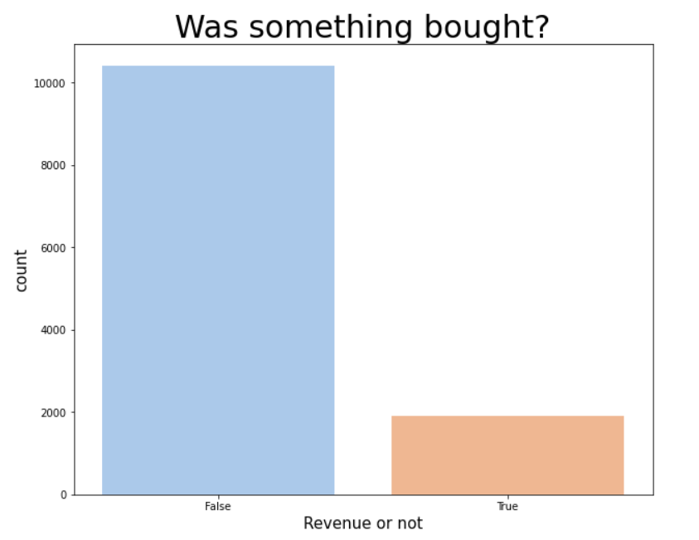
Dataset Preprocessing
The Dataset is read and checked for any missing data points in the dataset.
Then the data types of the features were checked and we had 2 categorical data.
We plotted the distribution of customers on Revenue and verified the values by label encoding Revenue column.

Slide 7
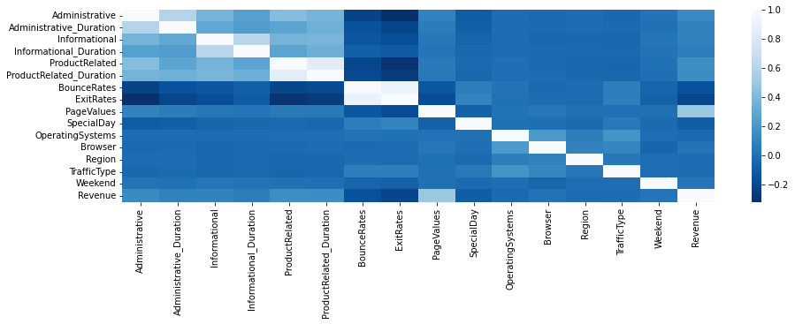
Dataset Preprocessing
Now we store the target column in y and remove the target column i.e. Revenue from X.
Some other columns (Operating System, Browser, Region and Traffic Type) are dropped.
We then check the shape of X & y and proceed to make train-test-split (80% and 20%).

Slide 8
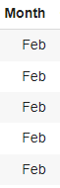
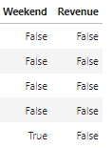
One Hot encoding
We can’t have text in our data if we’re going to run any kind of model on it.
Categorical text data into model-understandable numerical data.
After label encoding, we might confuse our model into thinking that a column has data with some kind of order.

Slide 9
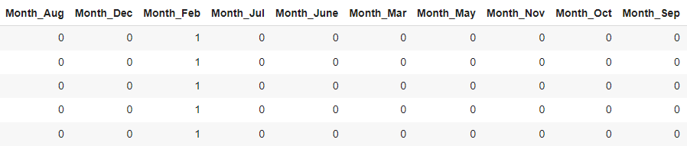
One Hot encoding
What one hot encoding does is, it takes a column which has categorical data, which has been label encoded, and then splits the column into multiple columns.
Replaced by 1s and 0s.

Slide 10
Classification Models
Logistic Regression
Linear SVM Model
Quadratic SVM Model
K-nearest Neighbors Model
Random Forest Classifier
Neural Networks for Classification

Slide 11
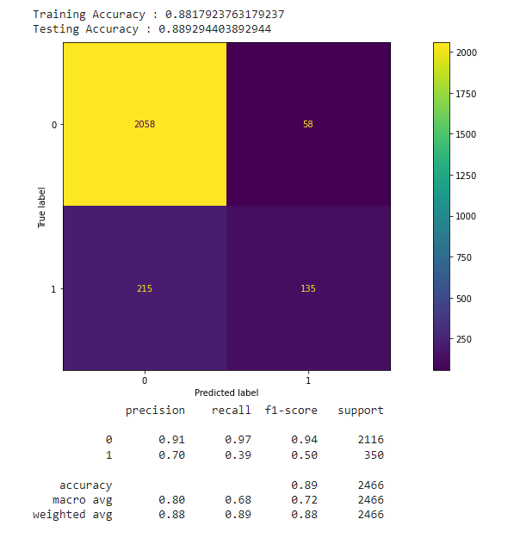
Logistic Regression
01
1
88.92%
Accuracy

Slide 12
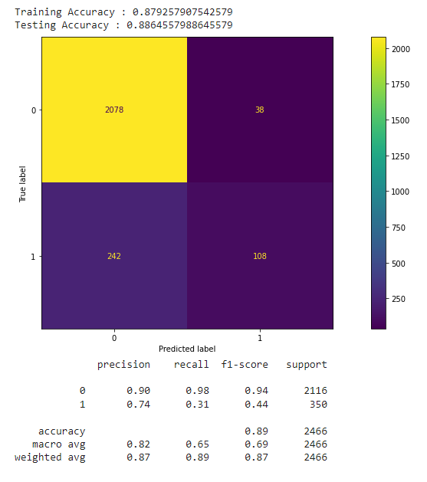
Linear SVM Model
02
1
88.64%
Accuracy

Slide 13
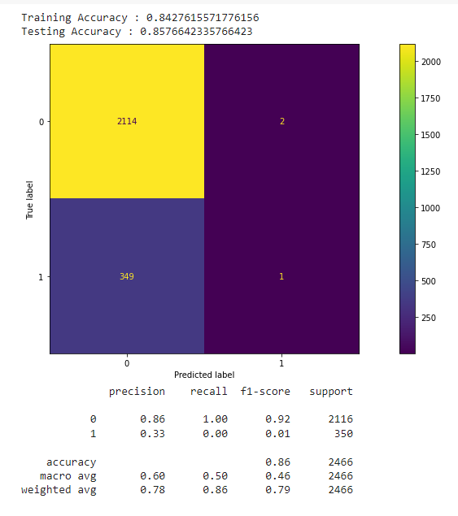
Quadratic SVM Model
03
1
85.76%
Accuracy

Slide 14
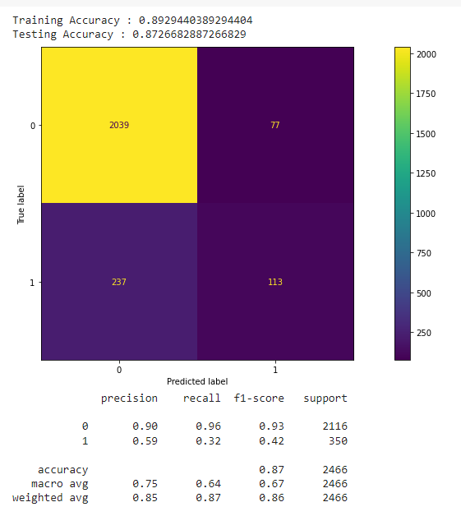
K nearest Neighbors Model
04
1
87.26%
Accuracy

Slide 15
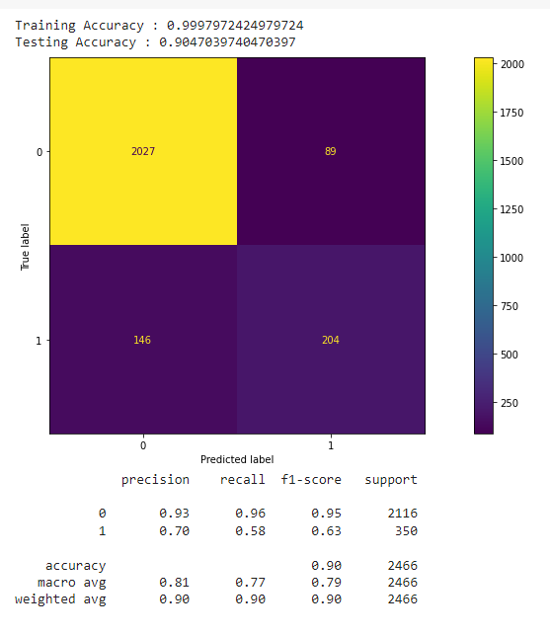
Random Forest Classifier
05
1
90.47%
Accuracy

Slide 16
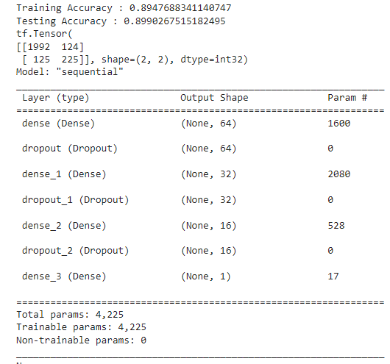
Neural networks for Classification
06
1
89.90%
Accuracy

Slide 17
CONCLUSION
All the models performed with accuracies greater than 85%
But precision and F1-score must also be consider to avoid cases like one class classification.
Considering all these factors, among the above mentioned classification models, we can conclude that Random Forest Classifier is the best for the given dataset.
The Random Forest models reaches the highest accuracy with 90.47%, followed by the Neural Networks classification model with 89.90% accuracy.

Slide 18
References
1. https://link.springer.com/article/10.1007/s00521-018-3523-0
2. https://scikit-learn.org/stable/
3.https://contactsunny.medium.com/label-encoder-vs-one-hot-encoder-in-machine-learning-3fc273365621

